Slide 1
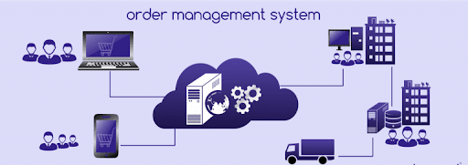
ORDER MANAGEMENT SYSTEM
Created By:-
Aditya Vikram Sarkar
Sr.Analyst Intern
Capgemini India

Slide 2
Abstract
The Order Management System is a Salesforce based solution for Orders.
It consolidates data provided by different product brands and provide the user details like price,quantity,discounts,etc in real-time.
The user may want to choose different products based on different aspects,our system allows them to make a search based upon Product Name,Brand and MRP and can select products based upon the shown product list.
The Lightning App allows them to confirm order and cancel order and a invoice will be shown at the end.
Email notifications are sent to respective user and it’s contacts when stage of order is changed.

Slide 3

Users In The System
Sales User
Bussiness User
Support Team

Slide 4
1.The Sales User can:
Login
Create Order
Cancel Order
View Order Details
Generate Approvals(Order amount above 100000)
View Reports
2.Business Users can:
Login
View Orders and Invoices
View Reports
Accept/Reject Approvals
3.Support Team can:
Login
Create Users
Assign Roles
Create/View/Edit Orders
CRUD Operations on Records

Slide 5
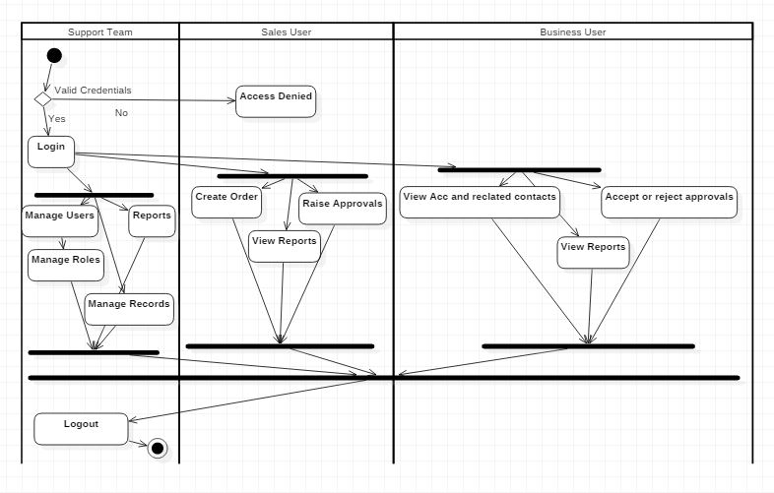
Activity Diagram

Slide 6
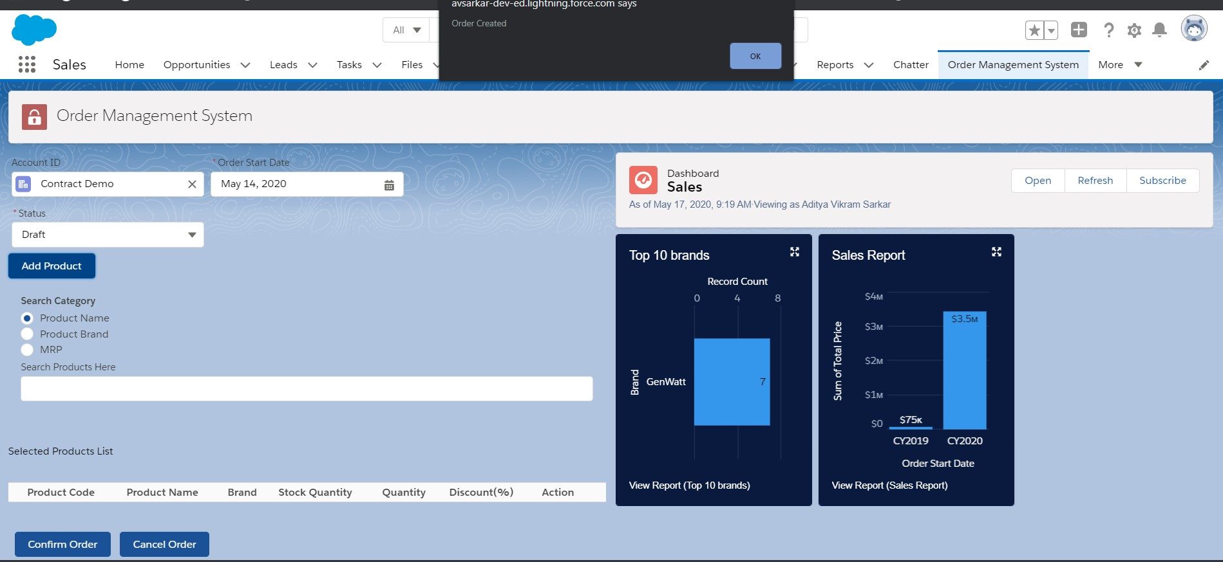
Creating Order

Slide 7
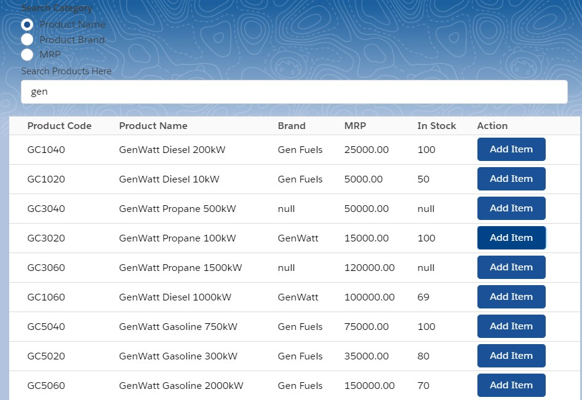
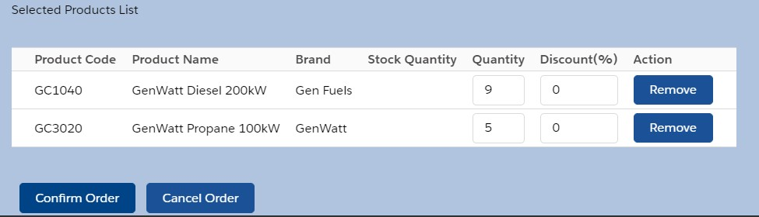
Searching Products & Adding Quantity

Slide 8
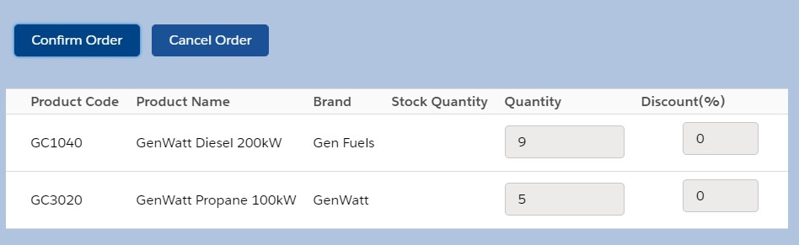
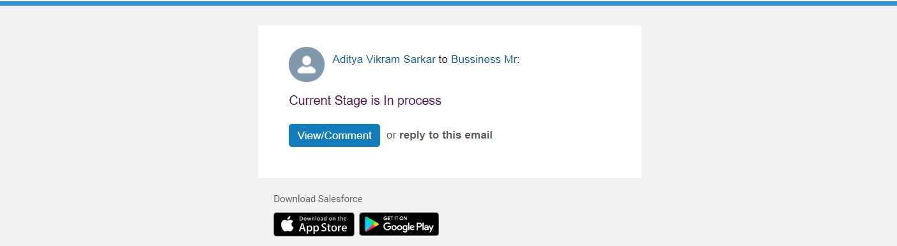
Confirming Order And Email Notification

Slide 9
Validation & Assumptions:-
Desired Quantity cannot be negative.
Discount cannot be negative or more than 100%.
Order after creation by sales user cannot be deleted,it can only be done by the Support Team/Admin.
Stages cannot be changed to prior stages.
Sales User can handle only 5 accounts.

Slide 10


